Slide 1



Physics-assisted Generative Adversarial Network for X-Ray Tomography
Zhen Guo

Slide 2
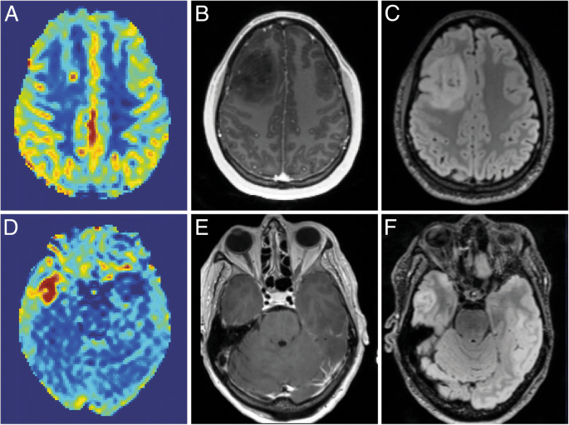
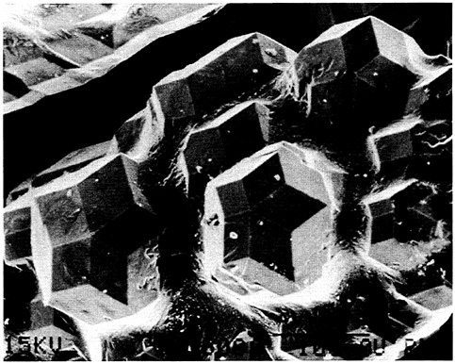
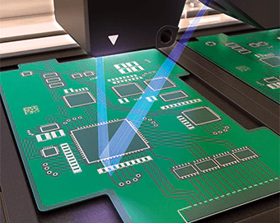
Machine Learning for X-ray Tomography
Zhen Guo, Jung Ki Song, George Barbastathis, Michael E. Glinsky, Courtenay T. Vaughan, Kurt W. Larson, Bradley K. Alpert, Zachary H. Levine
Department of Electrical Engineering and Computer Science, Department of Mechanical Engineering, Massachusetts Institute of Technology,
Singapore-MIT Alliance for Research and Technology (SMART) Centre, Sandia National Laboratory Albuquerque, Applied and Computational Mathematics Division,
National Institute of Standards and Technology, Quantum Measurement Division, National Institute of Standards and Technology

Slide 3
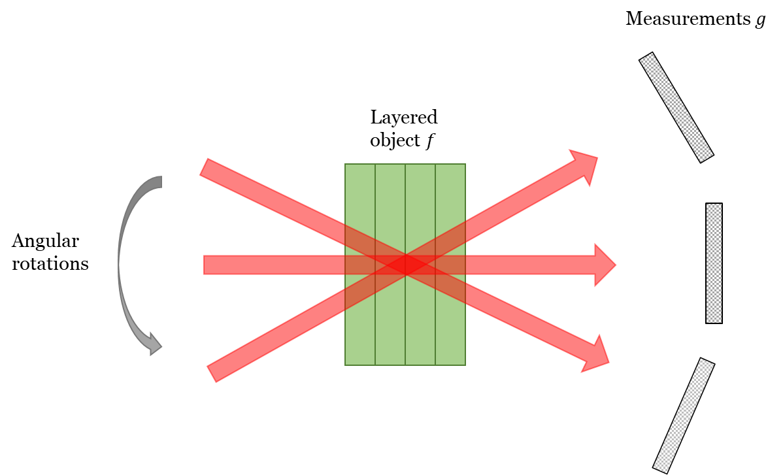
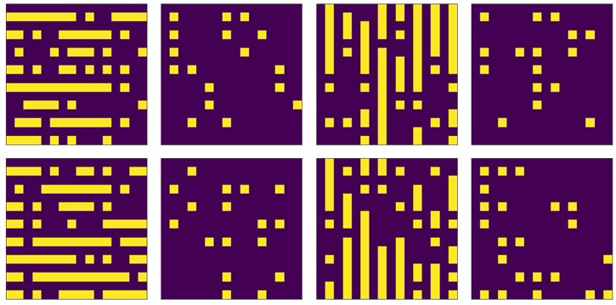
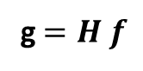
g $=H f$
Notes:
This long standing ill-posed problem is fundamental to many applications such as robot navigation, object recognition and scene understanding, 3D modeling and animation, industrial control, and medical diagnosis

Slide 4
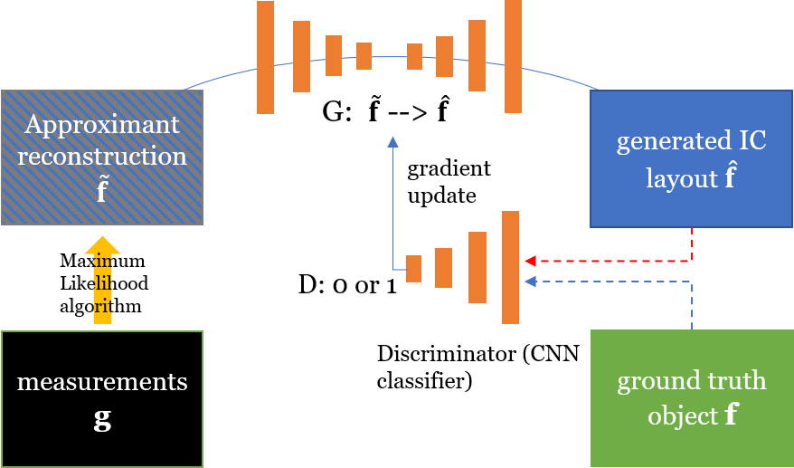
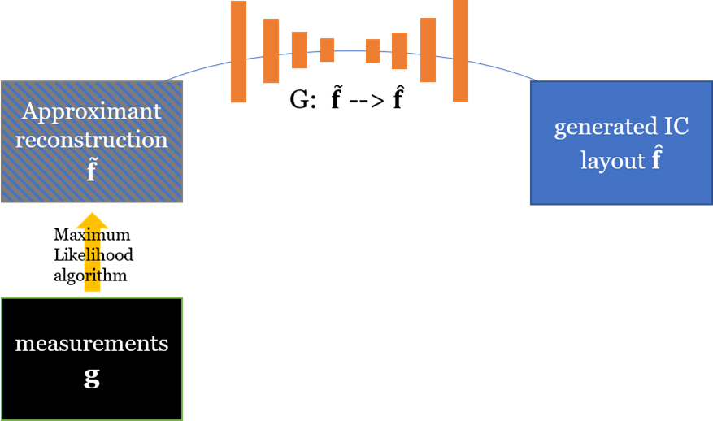
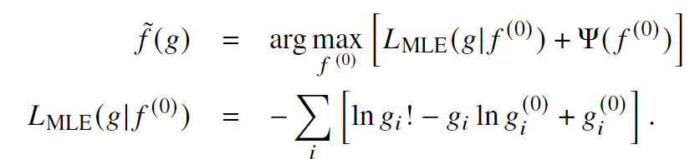
Notes:
This long standing ill-posed problem is fundamental to many applications such as robot navigation, object recognition and scene understanding, 3D modeling and animation, industrial control, and medical diagnosis

Slide 5
concatenated skip-connections
16 x 16 x 8 x 1
8 x 8 x 8 x 64
4 x 4 x 8 x 128
2 x 2 x 8 x 256
1 x 1 x 8 x 512
2 x 2 x 8 x 256
4 x 4 x 8 x 128
8 x 8 x 8 x 64
16 x 16 x 8 x 1
Down
ResBlock3
256 --> 512
Up
ResBlock1
512 --> 512
Down
ResBlock3
128 --> 256
Up
ResBlock2
512 --> 256
Down
ResBlock2
64 --> 128
Up
ResBlock3
256 --> 128
Up
ResBlock4
128 --> 64
Down
ResBlock1
1 --> 64
Final
Conv
64 --> 1
Up / Down
ResBlock
ReLU
BatchNorn
Conv 3x3x3
ReLU
BatchNorn
Conv 3x3x3
Up / Down sample
Up / Down sample
Conv 1x1x1
Notes:
This long standing ill-posed problem is fundamental to many applications such as robot navigation, object recognition and scene understanding, 3D modeling and animation, industrial control, and medical diagnosis

Slide 6
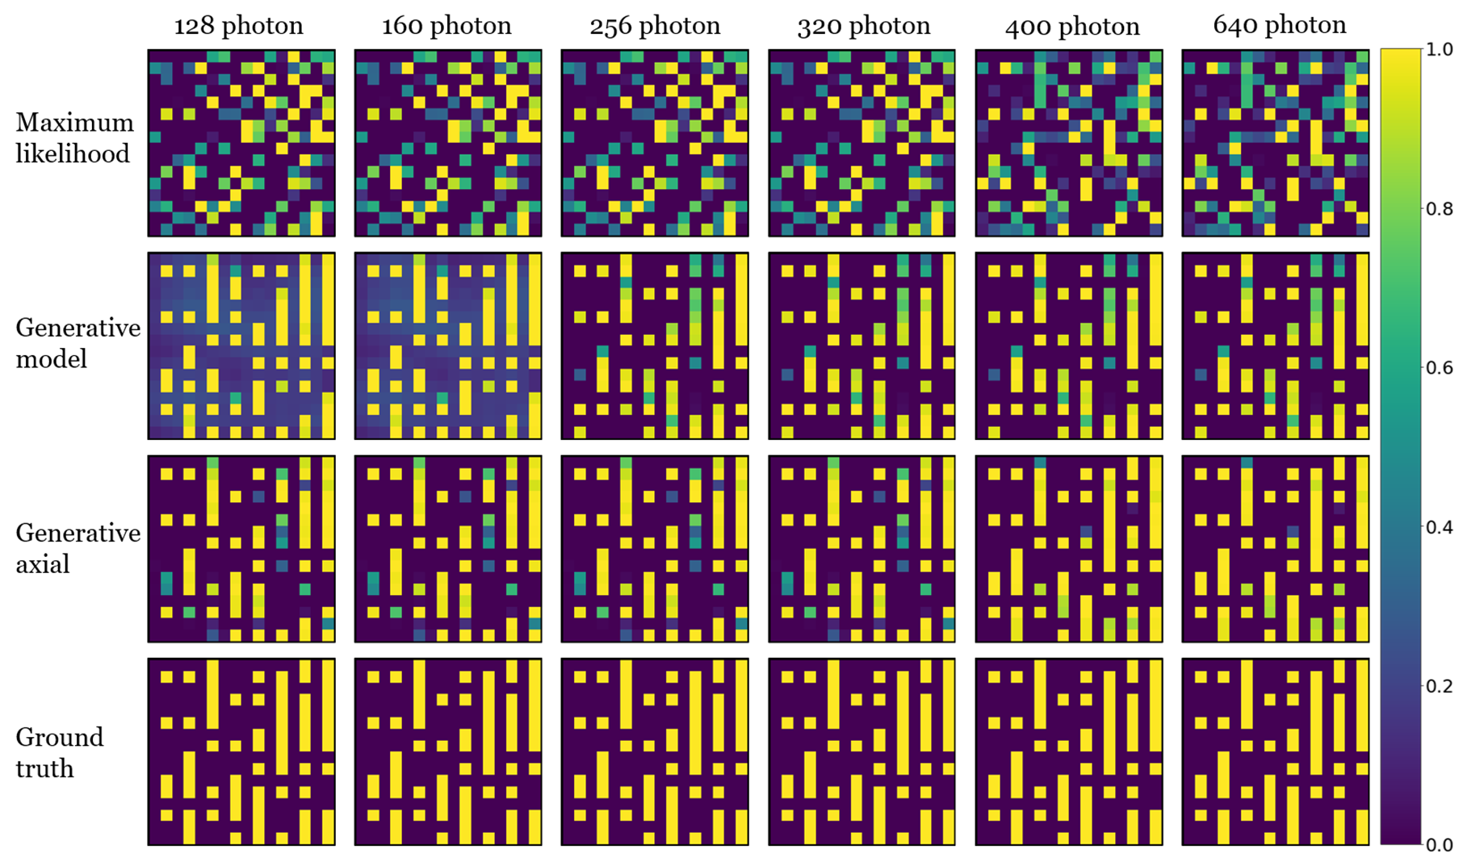
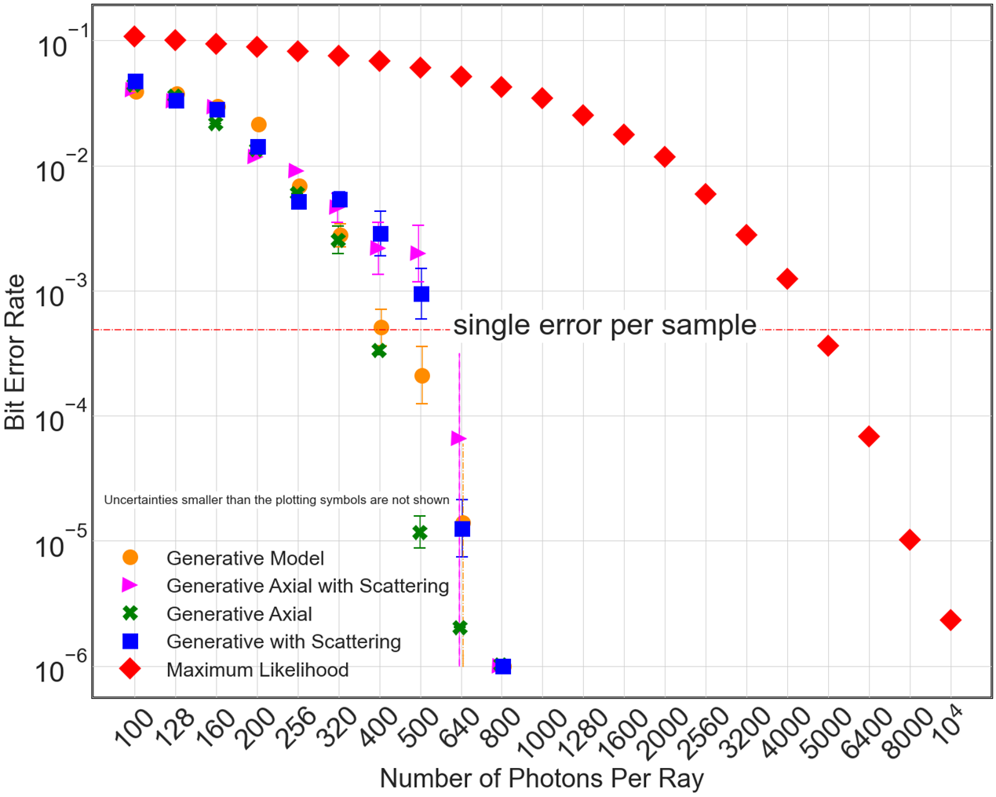
Notes:
This long standing ill-posed problem is fundamental to many applications such as robot navigation, object recognition and scene understanding, 3D modeling and animation, industrial control, and medical diagnosis

Slide 7
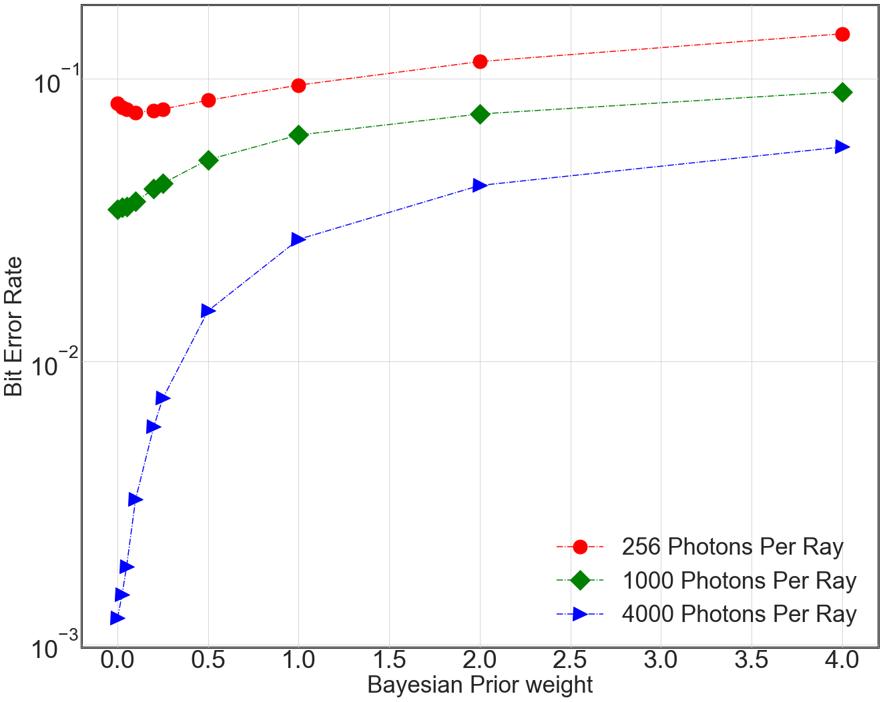
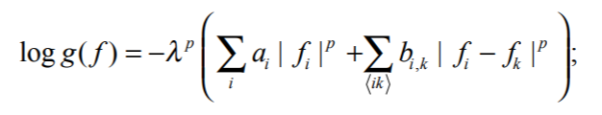
Notes:
This long standing ill-posed problem is fundamental to many applications such as robot navigation, object recognition and scene understanding, 3D modeling and animation, industrial control, and medical diagnosis

Slide 8
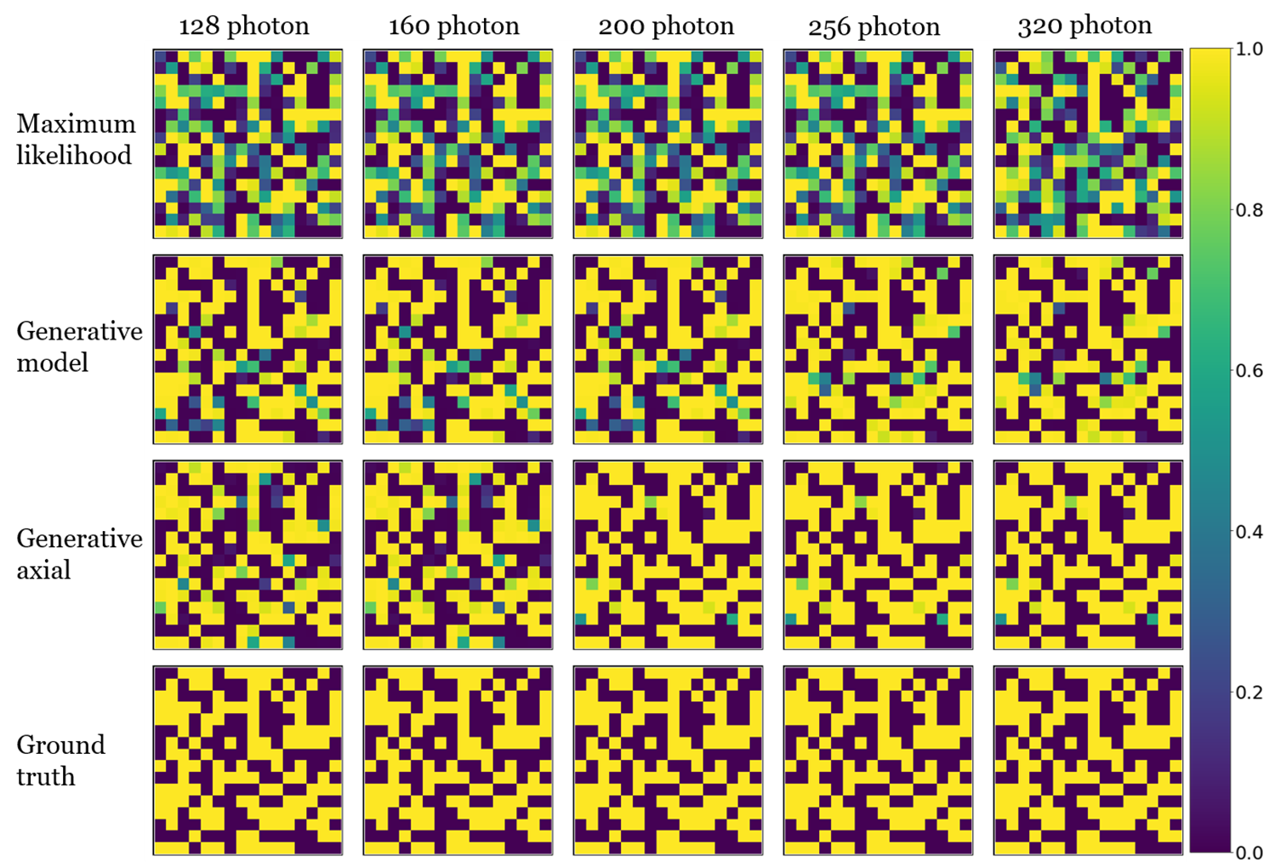
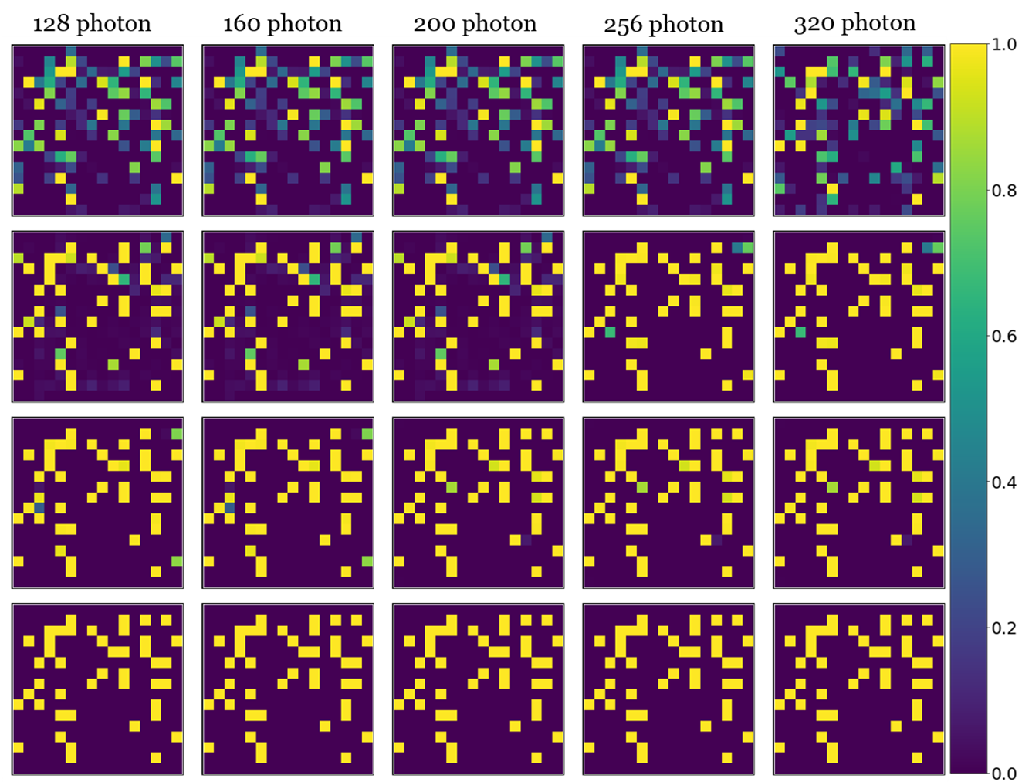
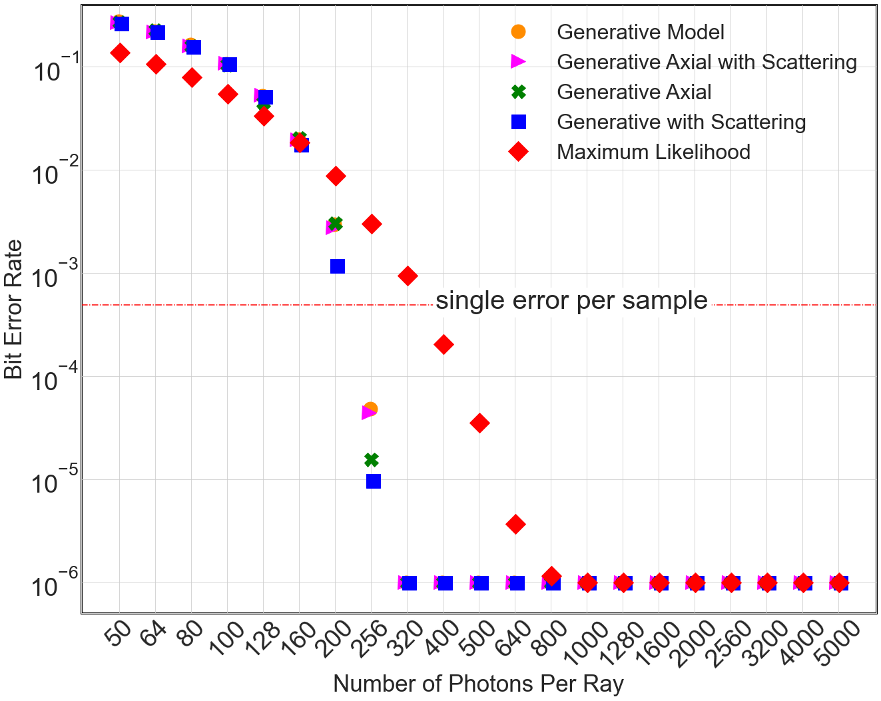
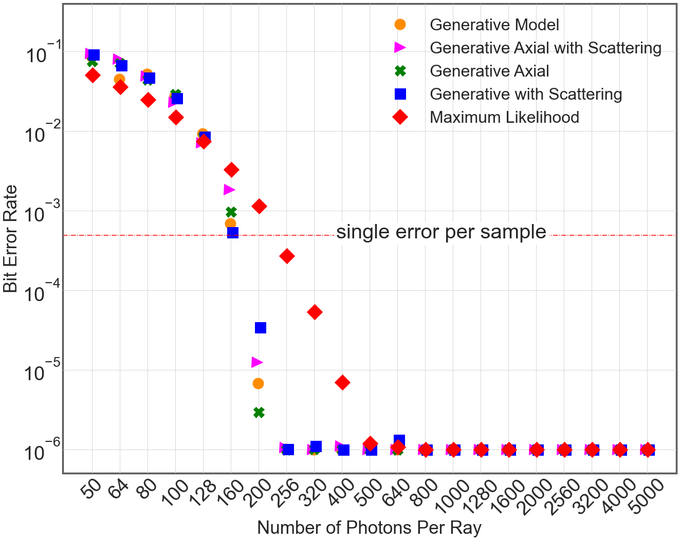
Notes:
This long standing ill-posed problem is fundamental to many applications such as robot navigation, object recognition and scene understanding, 3D modeling and animation, industrial control, and medical diagnosis

Slide 9
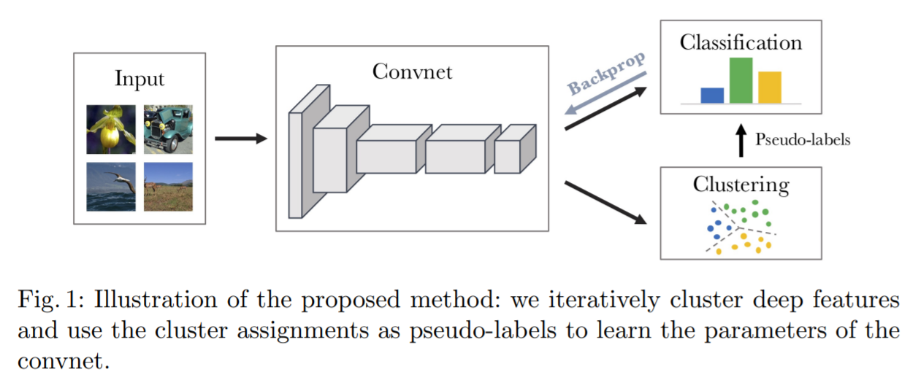
DeepCluster for unsupervised clustering
PCA
k-means clustering
1x num class
Back-prop
128 x 128 x 9 x 1
32 x32 x 3 x 64
8 x 8 x 1 x 128
4 x 4 x 1 x 256
2 x 2 x 1 x 512
1x 10
1x num class
Flatten
1x 2048
Dense
Dense
Down
ResBlock3
256 --> 512
Down
ResBlock3
128 --> 256
Down
ResBlock2
64 --> 128
Down
ResBlock1
1 --> 64
Caron, Mathilde, et al. "Deep clustering for unsupervised learning of visual features." Proceedings of the European conference on computer vision (ECCV). 2018.
Notes:
This long standing ill-posed problem is fundamental to many applications such as robot navigation, object recognition and scene understanding, 3D modeling and animation, industrial control, and medical diagnosis

Slide 10
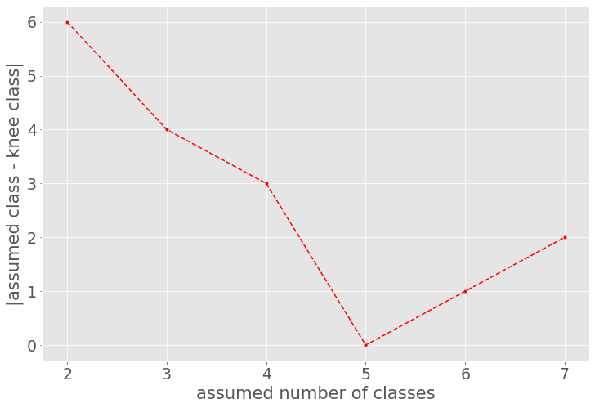
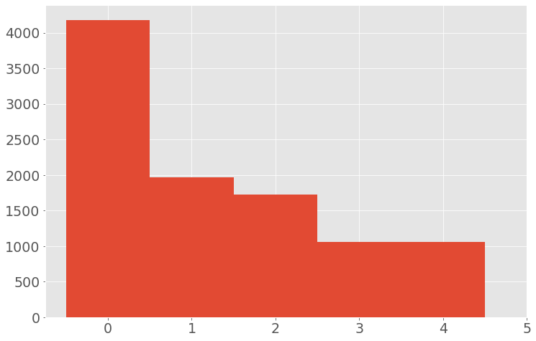
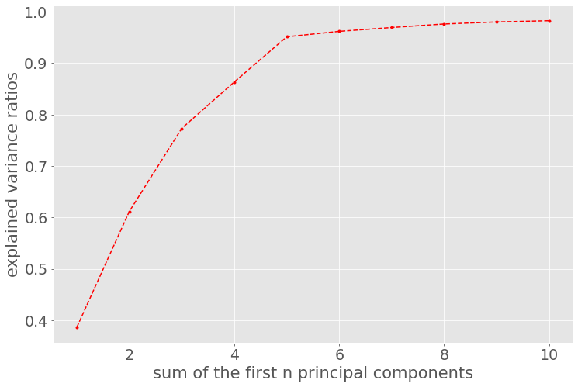
Notes:
This long standing ill-posed problem is fundamental to many applications such as robot navigation, object recognition and scene understanding, 3D modeling and animation, industrial control, and medical diagnosis

Slide 11
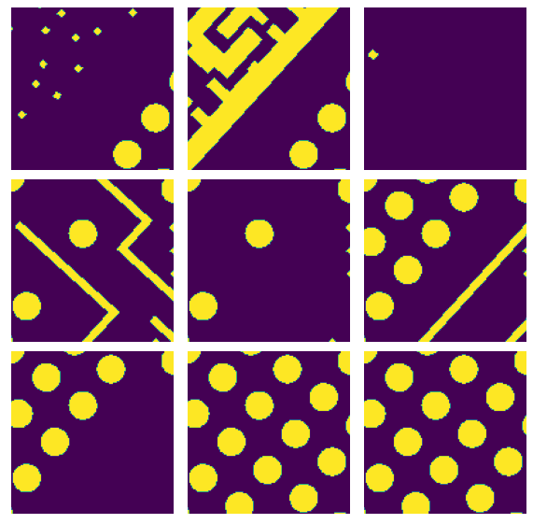
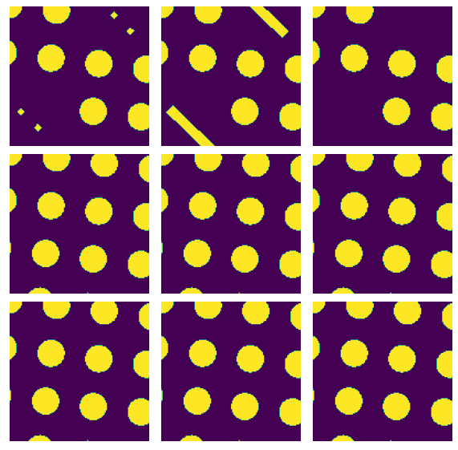
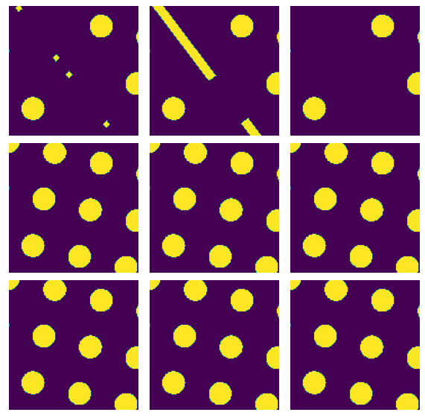
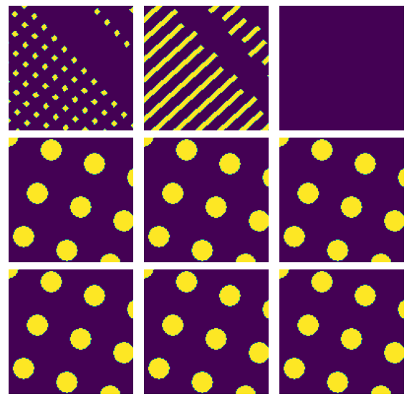
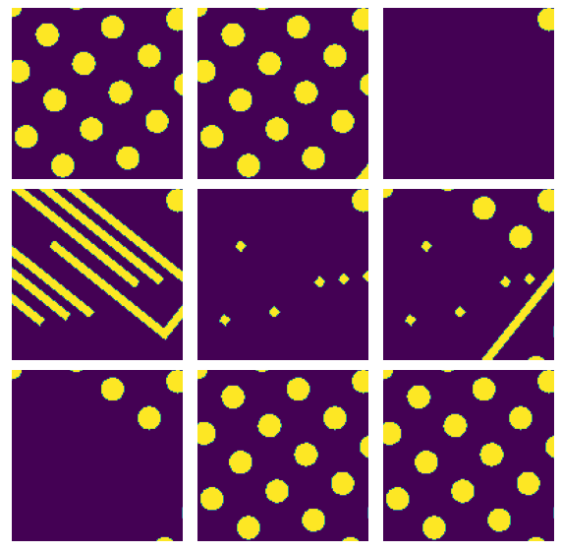
Notes:
This long standing ill-posed problem is fundamental to many applications such as robot navigation, object recognition and scene understanding, 3D modeling and animation, industrial control, and medical diagnosis

Slide 12
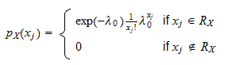
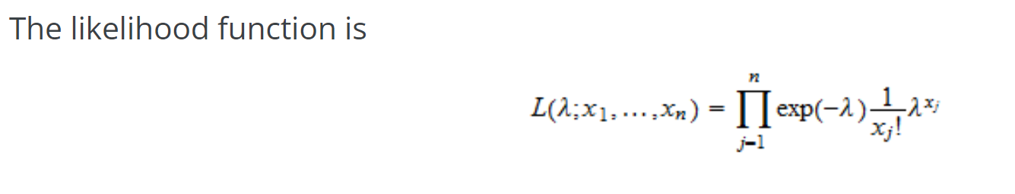
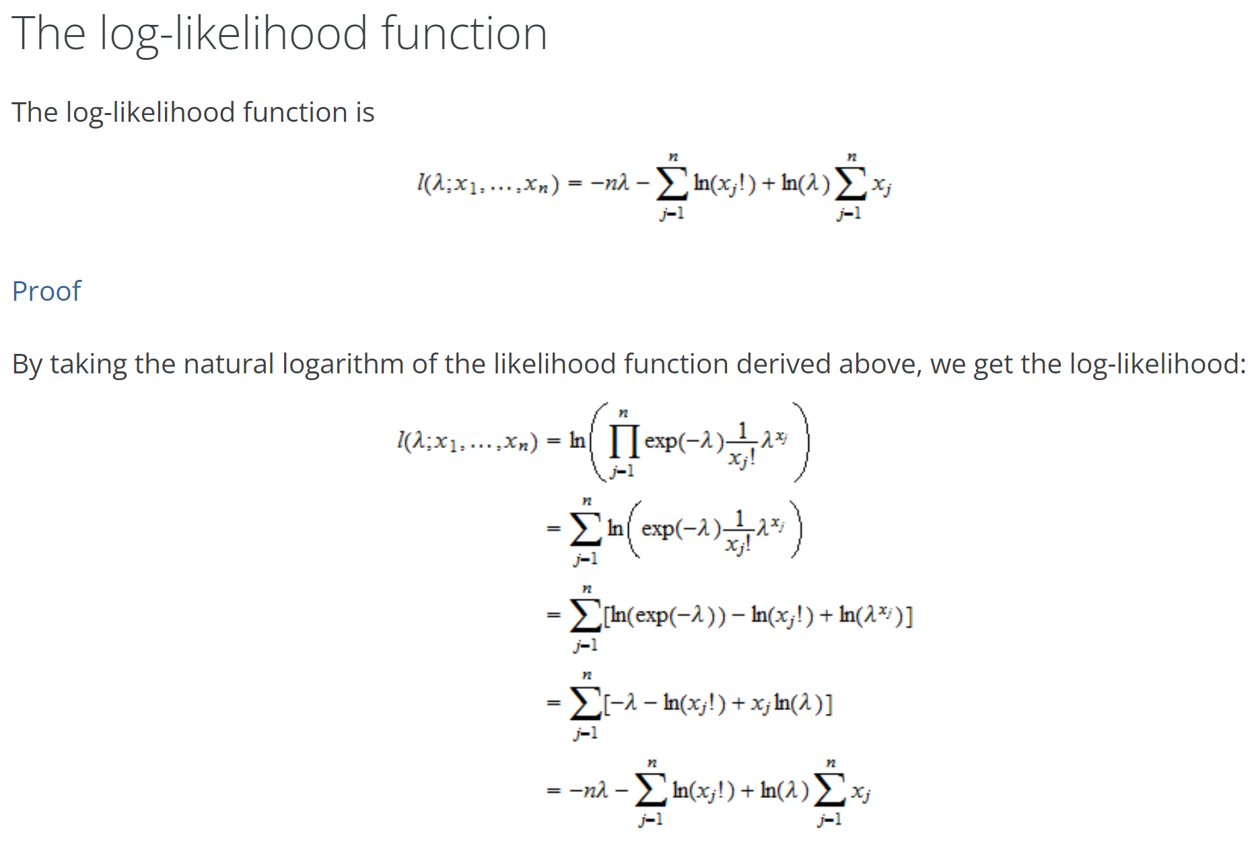
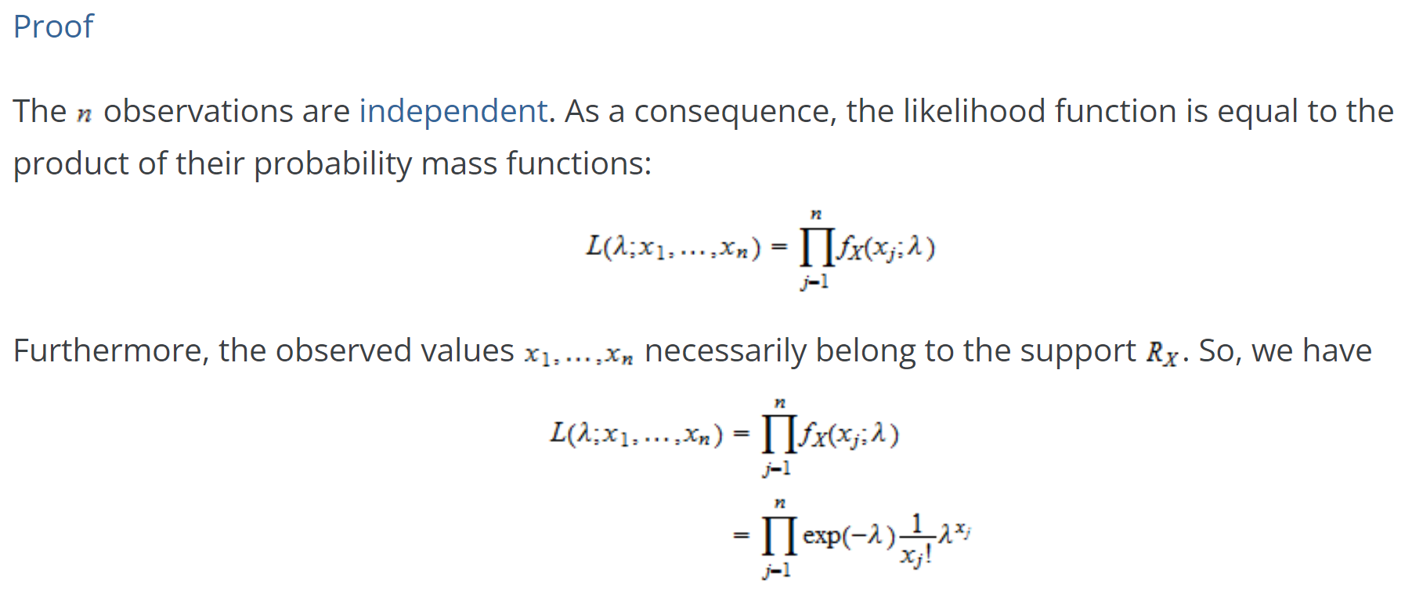
Notes:
This long standing ill-posed problem is fundamental to many applications such as robot navigation, object recognition and scene understanding, 3D modeling and animation, industrial control, and medical diagnosis

